Slide 1
Cllr Chris Dorn
Hart District Councillor
for Crondall Parish Council Annual Parish Meeting
11 May 2026
Just to caveat: These are my personal views. Additionally, Cllrs can't provide definitive planning or legal advice, but I’m happy to share my personal thoughts on matters while asserting my open mindedness to any related future planning applications or formal council decisions.

Slide 2
Devolution and Local Government Reorganisation (LGR)
What’s being changed?
  Devolution: Combined Authority Area (CAA)
  LGR: Combination of District and County into “Unitaries”
  Parishes – unchanged (largely)
Why the Changes?
  Simplify arrangements
  Claimed cost reductions ~£40/person/yr
Mandate?
  Government has authority to do this
    But….the changes in the south are not in line with the published criteria (those in the north rely on more relaxed interpretation)
  Hart Cllrs (cross-party): didn’t ask for or want this, but picked the least-worst option
Homepage - HSCCA Website
Devolution and local government reorganisation | About the Council | Hampshire County Council

Slide 3
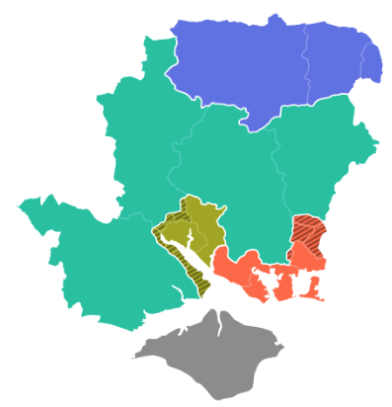
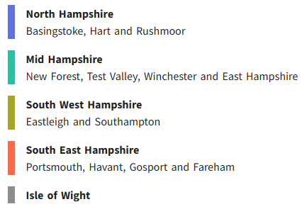
What’s Being Changed?
LGR: merge selected Districts, add-in Hampshire functions
  Create 5 Unitary Councils
  Goes live 1st Apr 2028
Devo: Hampshire and the Solent Combined County Authority
  Established and officer-led until 2028
  Known as the HSCCA, covering:-
    Transport and infrastructure
    Skills and employment
    Housing and strategic planning
    Economic development and regeneration
    Environment, climate change, health,
    well-being, public safety

Slide 4
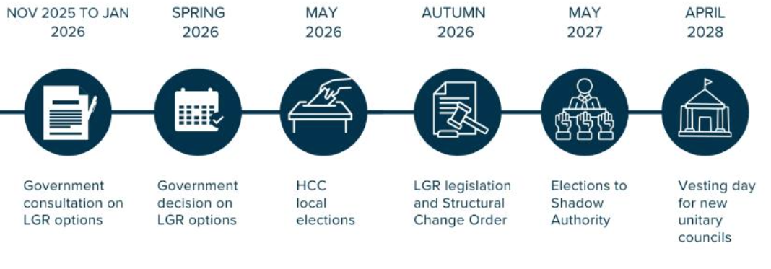
Timelines – LGR & CAA (Devolution)
Now
HDC & HCC – work as usual
North Hampshire delivers all services
& HDC
Joint Committee
85 Cllrs over 42 Wards
Shadow Council
Implementation team
Hampshire and the Solent Combined County Authority (HSCCA)
Mayoral Elections in May 2028

Slide 5
Hart Local Plan
Local Plan Notice of Intention – issued 29 Apr 2026
30 month process, should complete Oct 2028
Survives LGR process and would be completed under the Unitary
  To manage development in the area that “was Hart”
North Hampshire Unitary would need to start their own Local Plan soon after coming into being
  Possible that the CAA and Mayor could adjust the development targets
Housing & Employment Land Availability Assessment (HELAA) due in mid-May
  151+ sites submitted, still not enough
    Call for Sites still open
  Basingstoke has a “stepped trajectory”

