Slide 1
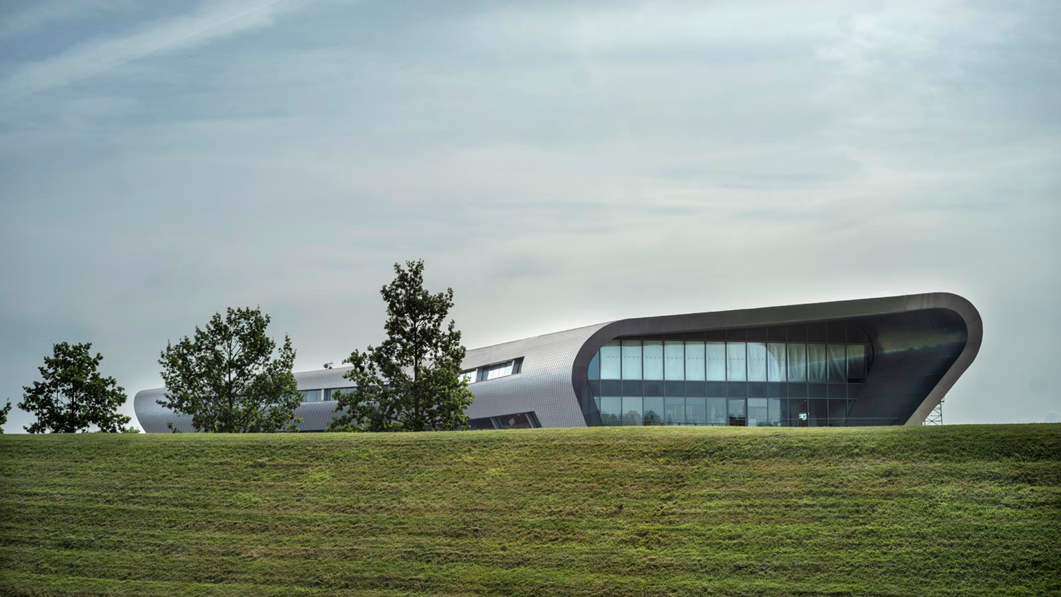

Connecting, Listening, Learning
Joanne Franco
AHEAD OF THE CURVE

Slide 2
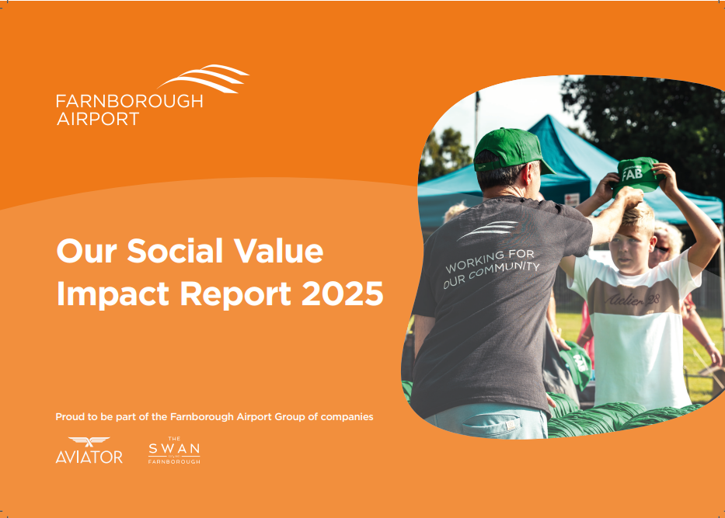
Why are we here?
To introduce our New Social Value Team
To build stronger relationships
To share our first Social Value Report

Slide 3
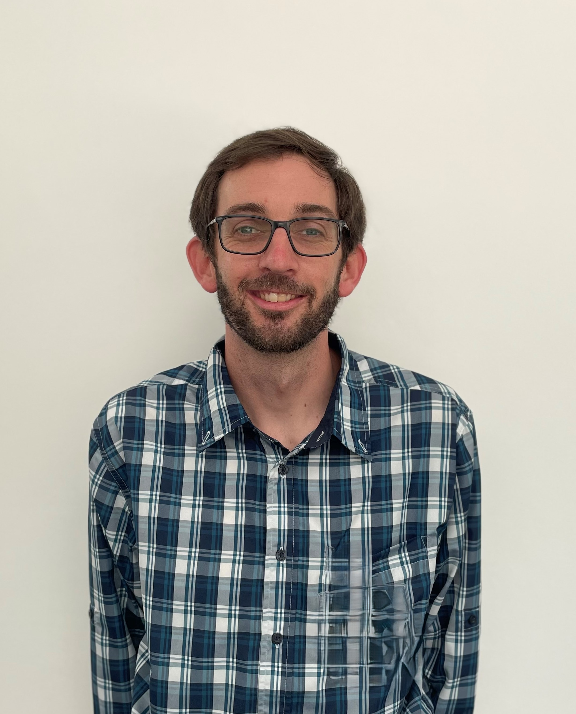
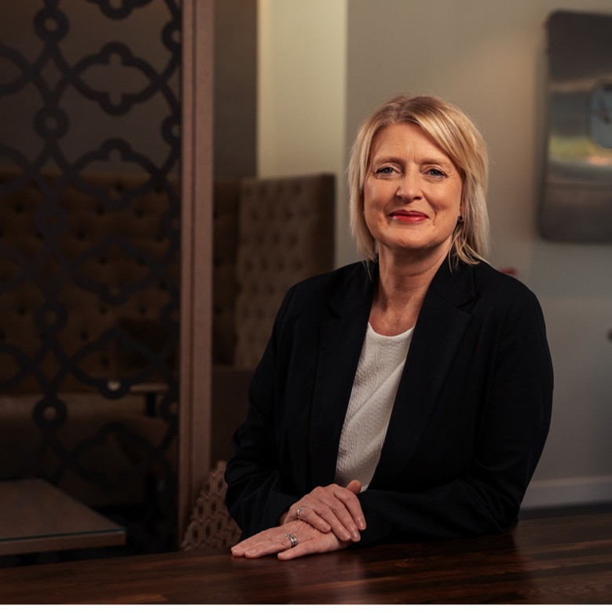
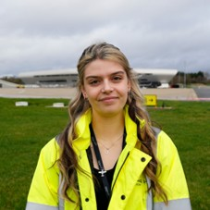
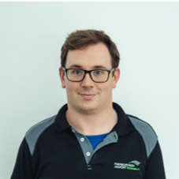
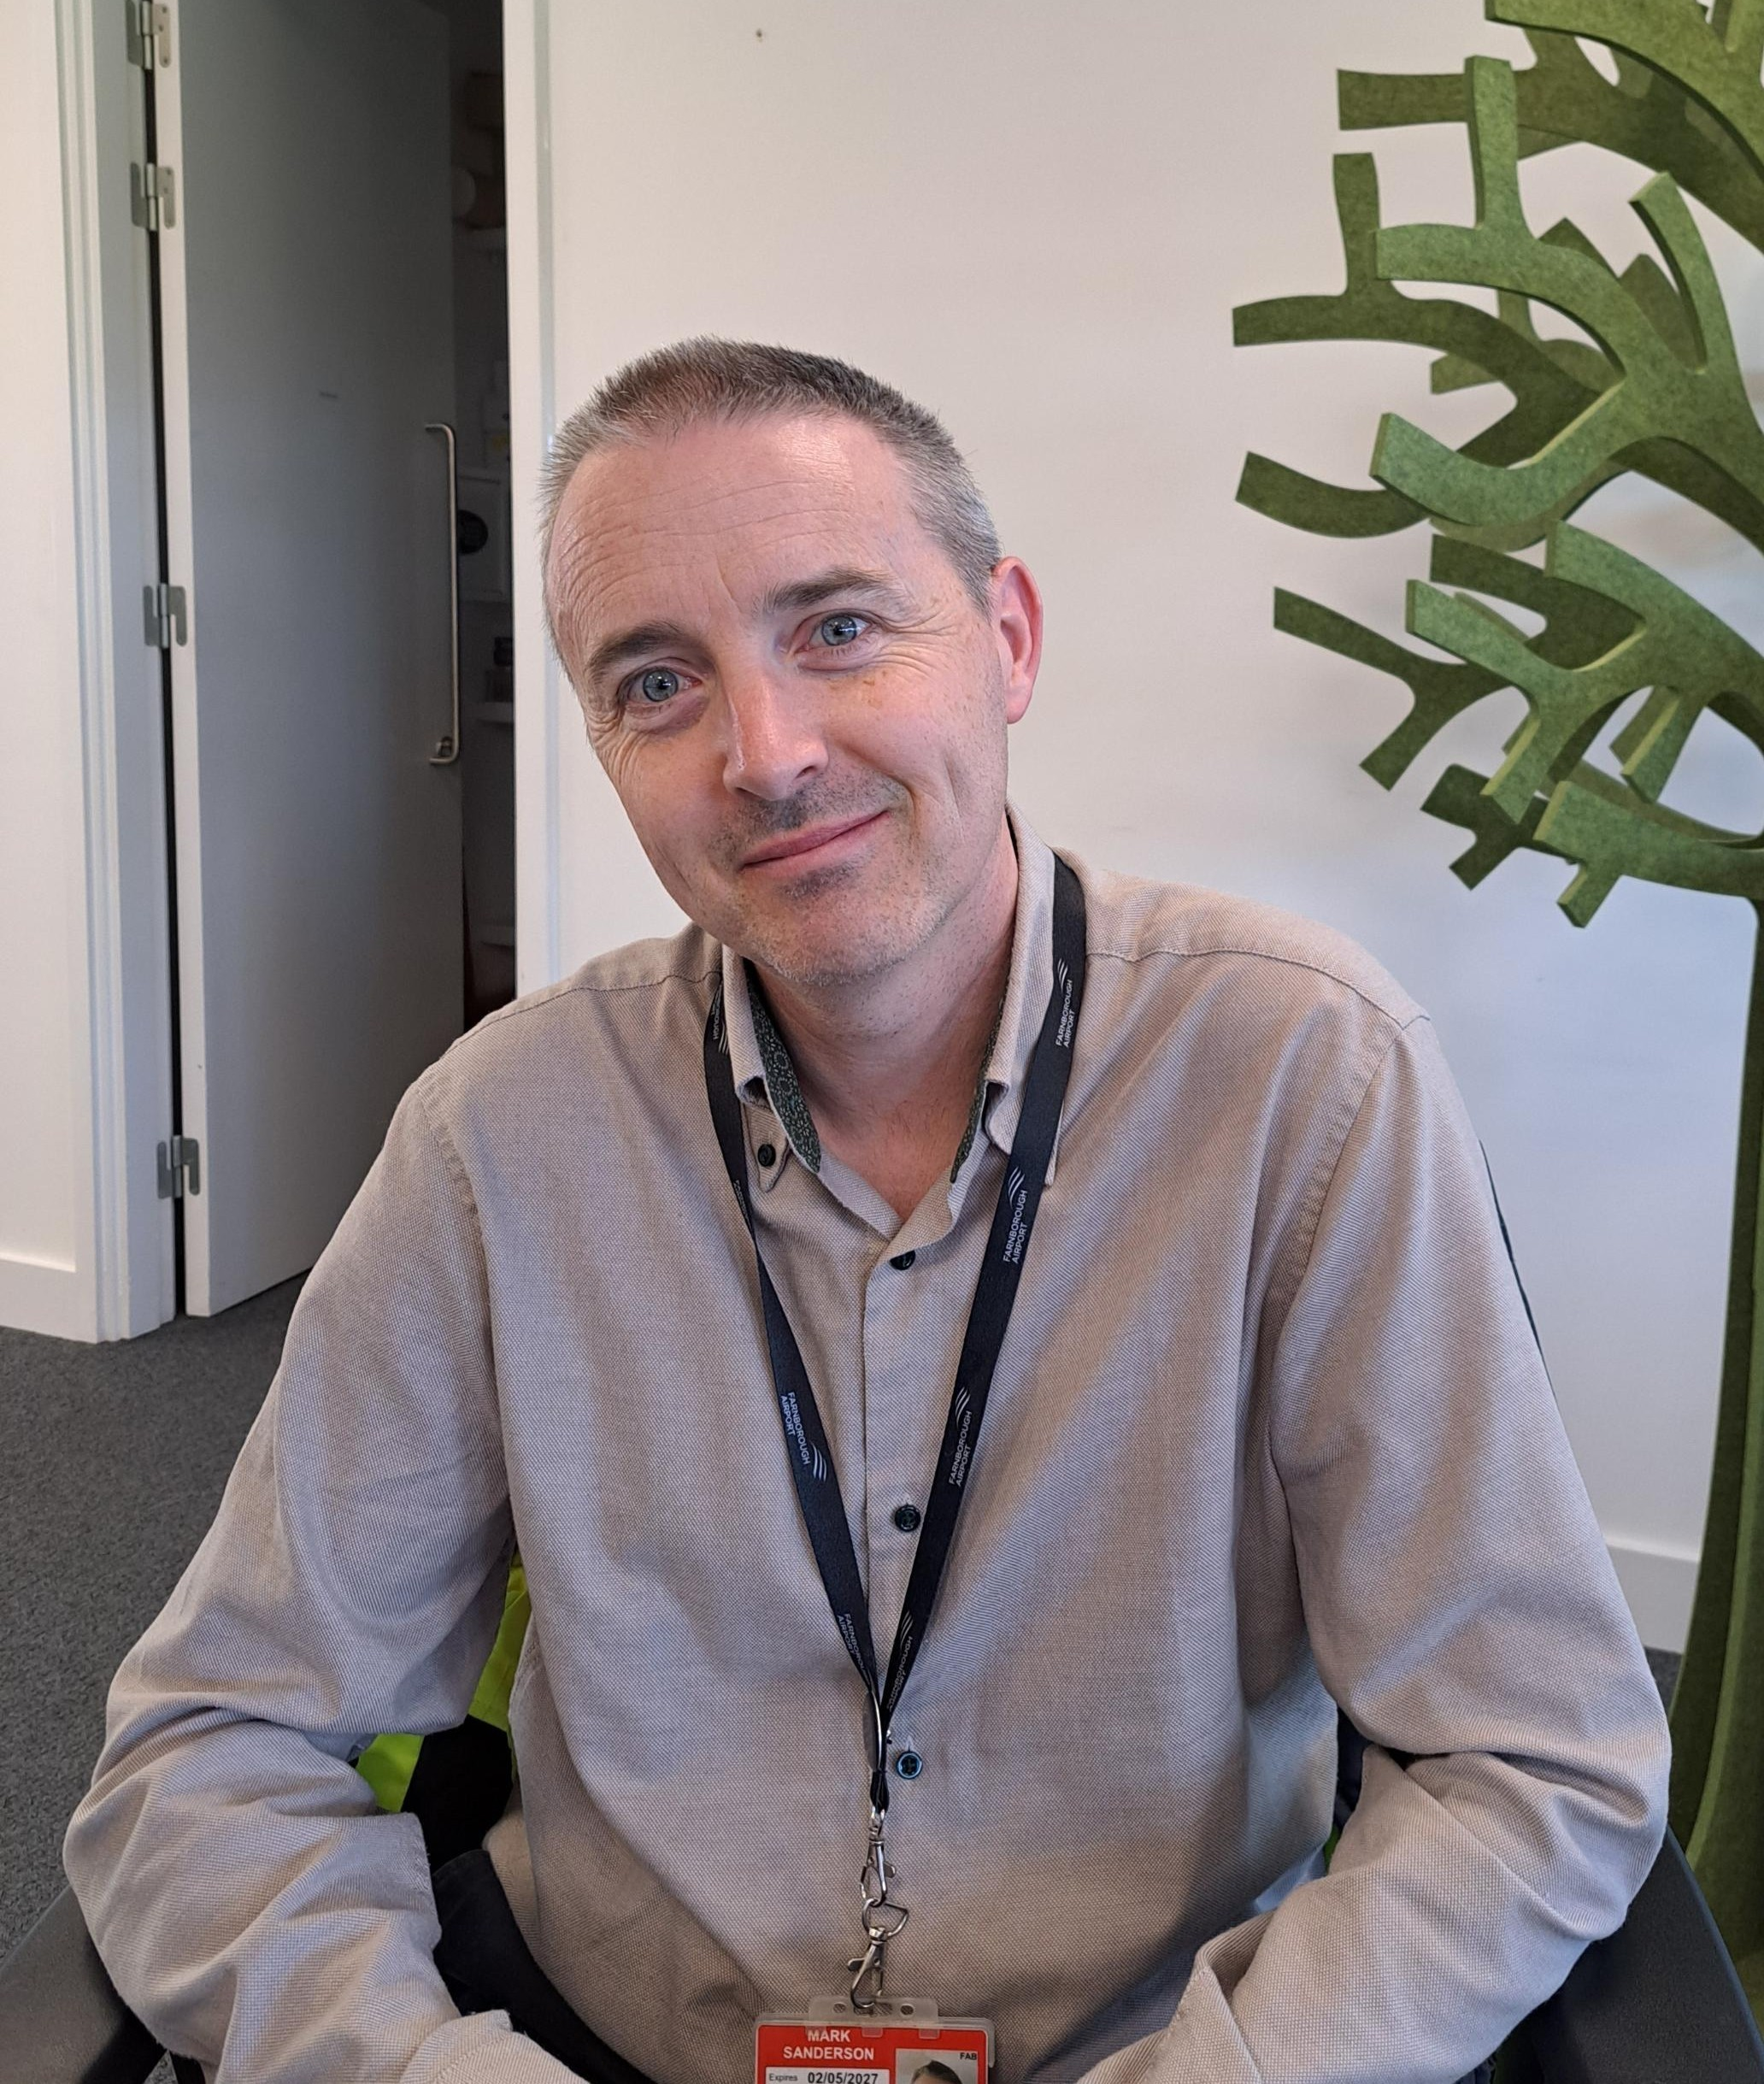
Meet the team
Our Responsibilities:
Gareth Andrews
Sustainability Manager
Joanne Franco
Head of Social Value & Planning
Sustainability
ESG
EMS/ISO14001
Biodiversity
Noise
Air Quality
Waste
Carbon Emissions
Water
Net Zero
Compliance
Airport Visits
Education
GRESB
Sponsorship & Funding
Events
Compliance
Volunteering
Peter Hookway-Russell
Sustainability Co-Ordinator
Faye Paizes
Corporate Responsibility and Sustainability Apprentice
Mark Sanderson
Group ESG Manager

Slide 4
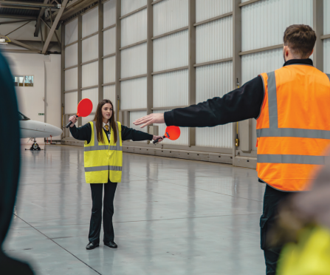
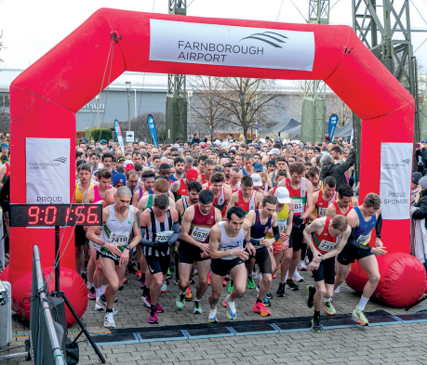
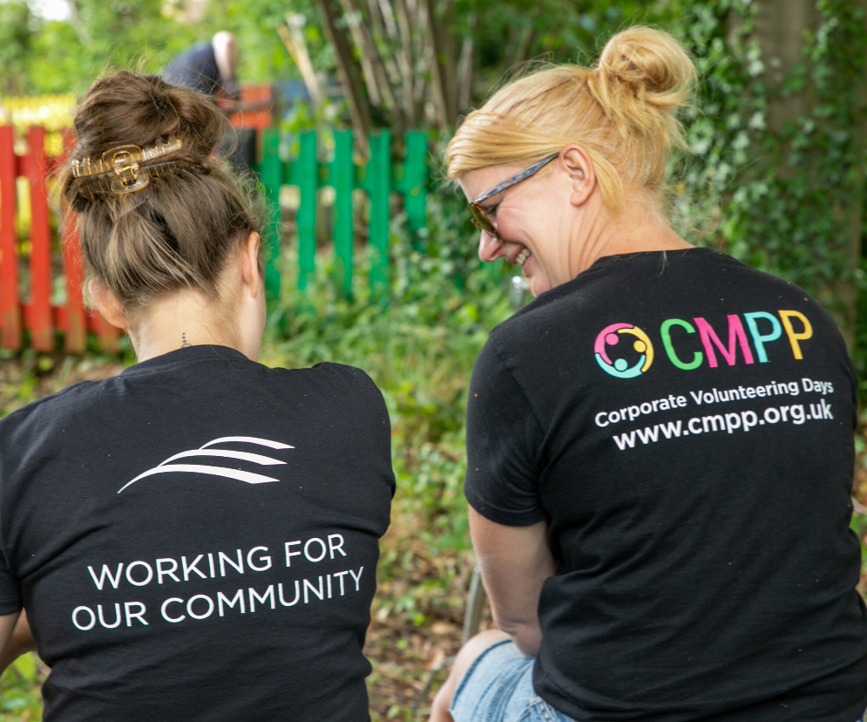
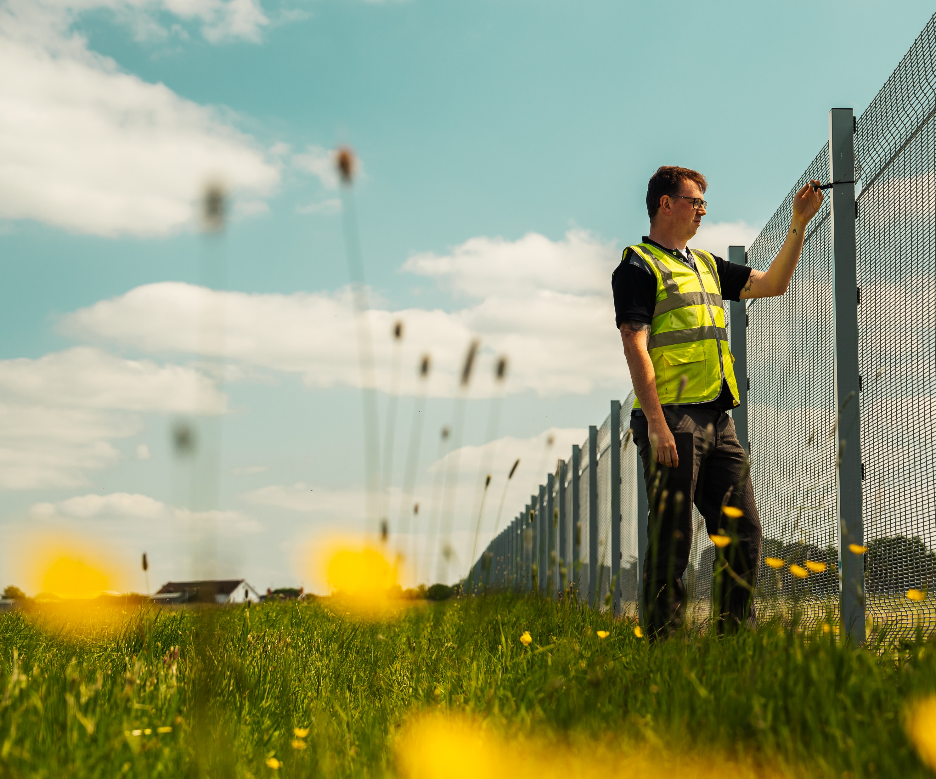
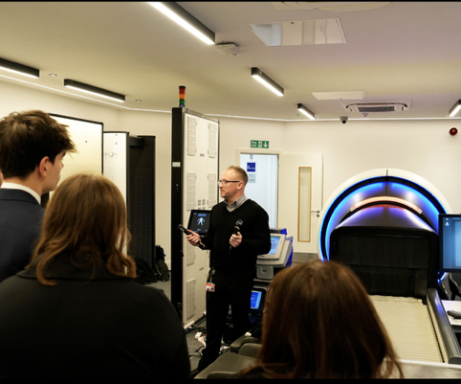
Ask us about
Education
Supporting charities and events
Volunteering
Environment & biodiversity
Community engagement

Slide 5
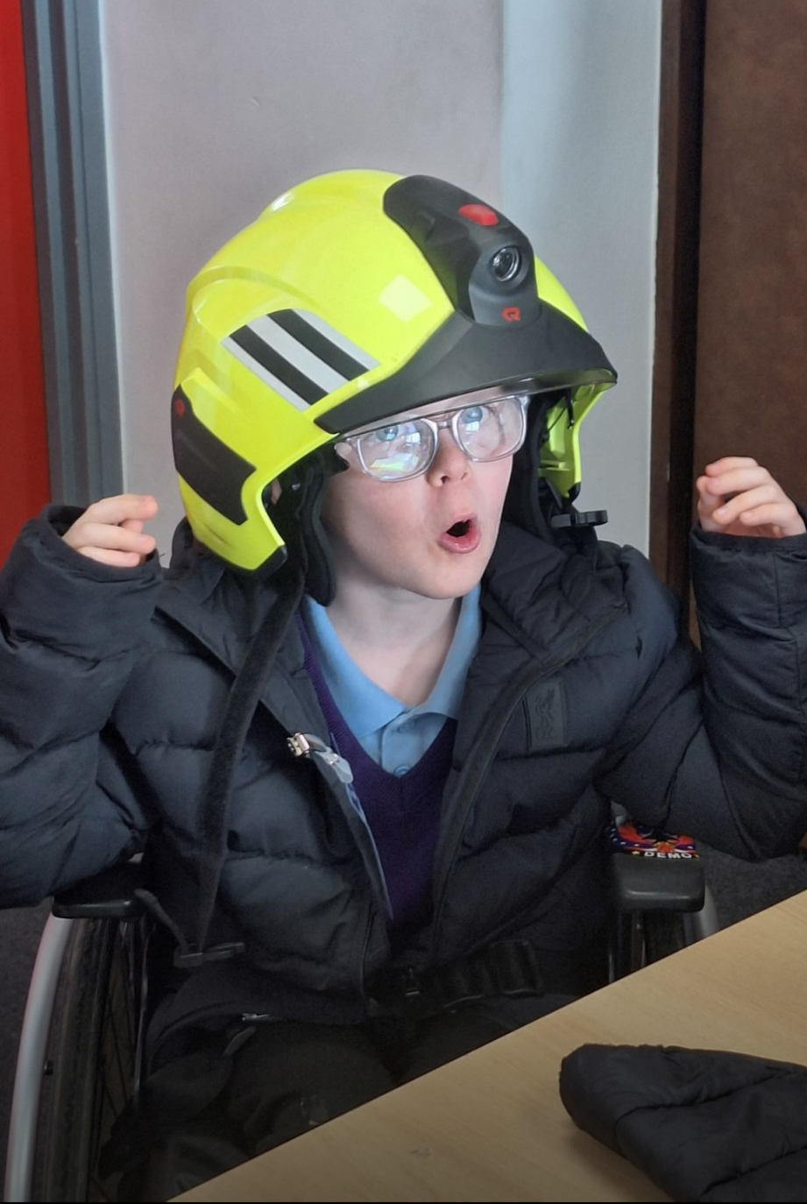
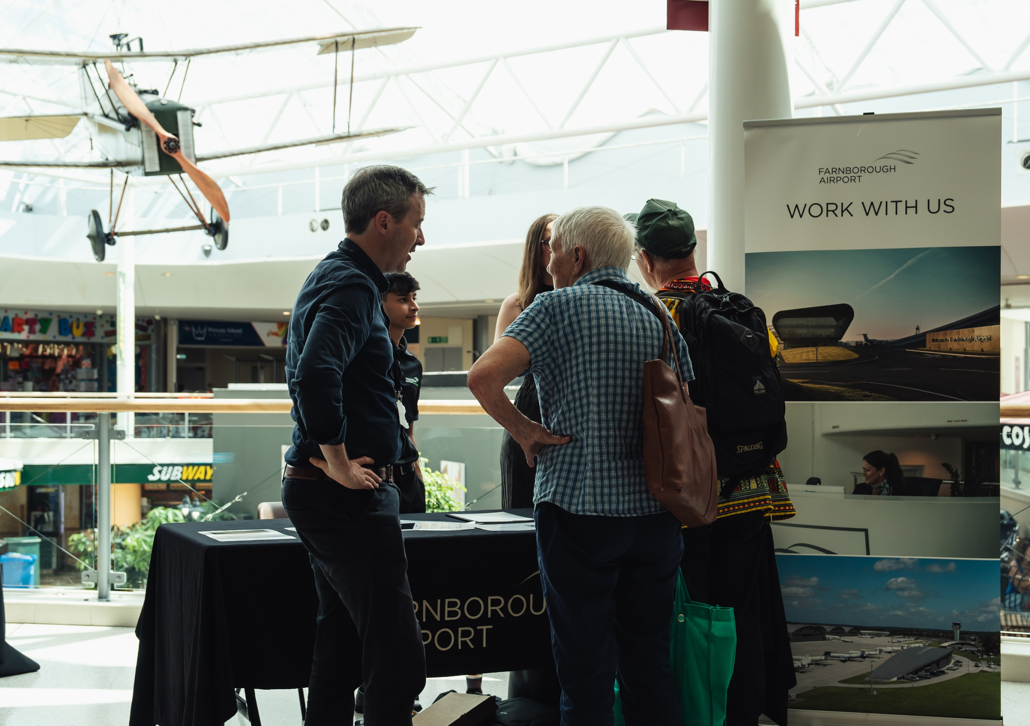
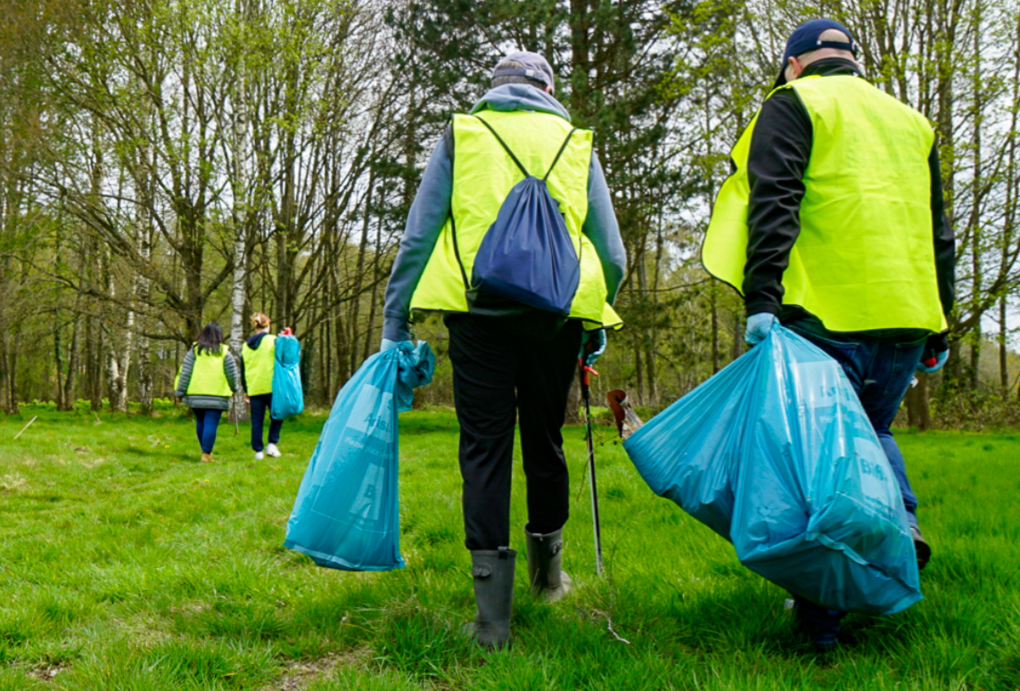
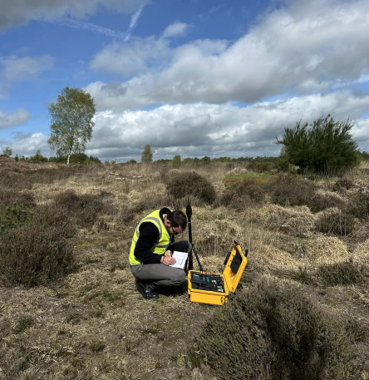
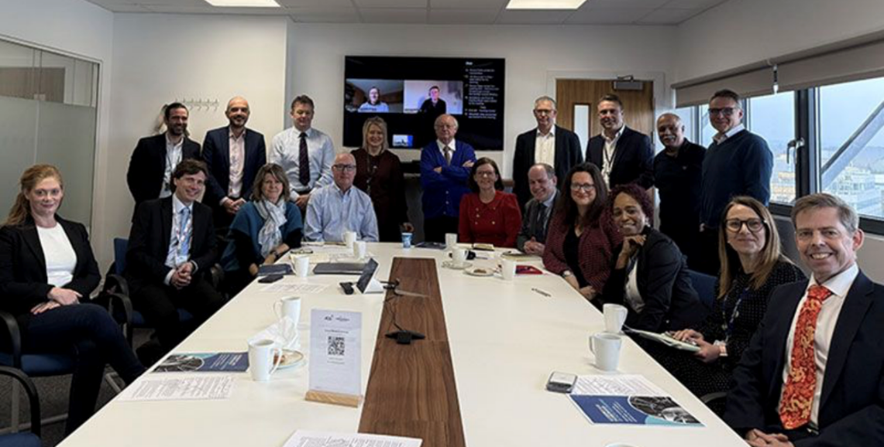
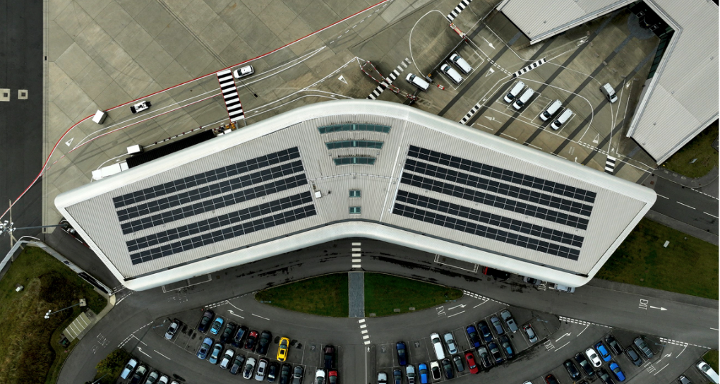
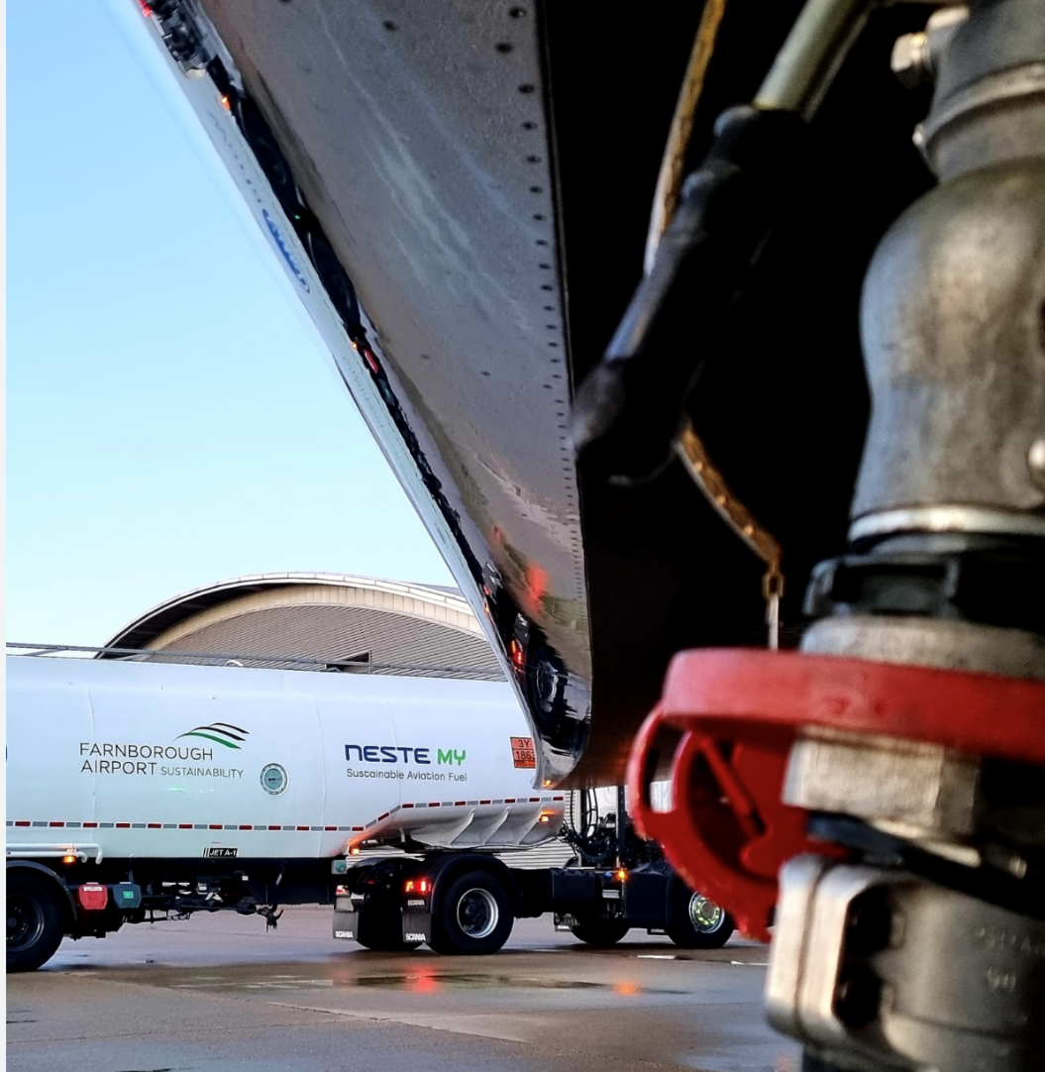
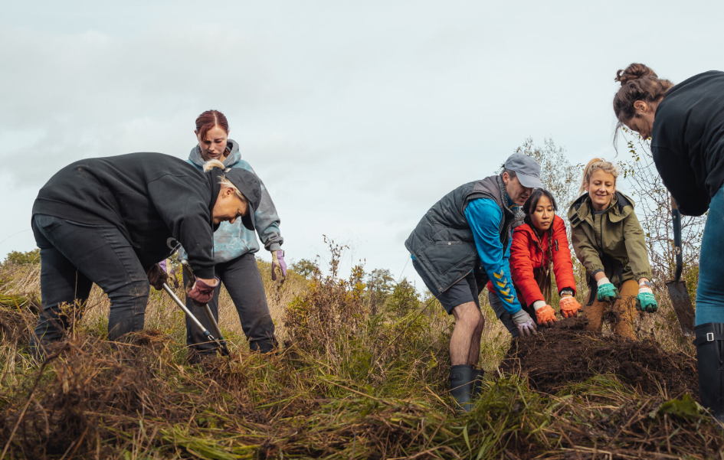
What does Social Value mean to you?
What matters most to Crondall
Tell us where we can contribute meaningfully
What would you like us to explain better
How can we build stronger relationships
Notes:
2026 so far …
6 community visits
12 school visits
Certificate in Airport Ops x 15
4 (x1 week) work experience
RAISE programme (14 students)
F6th Inspire programme (30 students)
Careers week (60 students Tower Hill, various assemblies)
Sponsorship
Half Marathon
Pride of Rushmoor Community Awards
Armed Forces Day
Reading Force
Community in Bloom
Volunteering
16 scheduled volunteering days

Slide 6

Lets talk!
AHEAD OF THE CURVE

