Slide 1


Event Overview
V0.2 - 11th May 2027

Slide 2
Agenda
Event Summary
Safety & Environmental Considerations
Which roads are we looking to utilise?
Q&A

Slide 3
Event Summary
Farnborough District Motor Club (400 members, est. 1958) are planning to run a closed road rally on 11th April 2027.
Legal closure of a 9 mile section of road between Crondall, Odiham & Long Sutton for one day.
Access to and from residences on the closed road route to be managed throughout the day.
Unique sporting spectacle.
Competing cars to be fully road legal, with additional safety equipment.
Police present to support the event, assure safety of spectator areas and enforce the legal road closure.
Ambulance & Paramedics to be present at our cost.
FDMC is affiliated with Motorsport UK (MSUK) and covered by a £100M insurance scheme.
Consulted with: Crondall, Odiham, Long Sutton and Froyle Parish Councils, HART Safety Advisory Group, Hart District Council, East Hants District Council, Hampshire County Council, Hampshire Highways, Hampshire and IOW Constabulary and RAF Odiham.

Slide 4
Safety & Environmental Considerations
Safety is our No. 1 priority.
The event will be stopped immediately by us if any safety issues are identified during the day.
Approximately 100 Safety Marshals required to cordon off access roads & public rights of way.
15 MSUK Licenced Officials required to run the event.
Three separate face-to-face visits of every property on the closed road route (First completed in March).
Our running cost is expected to be over £30,000.
FDMC does not aim to make a profit, but want the community to benefit from the event, both financially & enjoying the spectacle.
Schools, Scouts, Cricket Clubs, Landowners can all be involved with marquees, stalls, parking, spectator areas etc.
Community members can be trained to Marshal if they want to be more heavily involved in the event.
Environmental - noise limits, sustainable fuel & mandatory carbon offset by 2027.

Slide 5
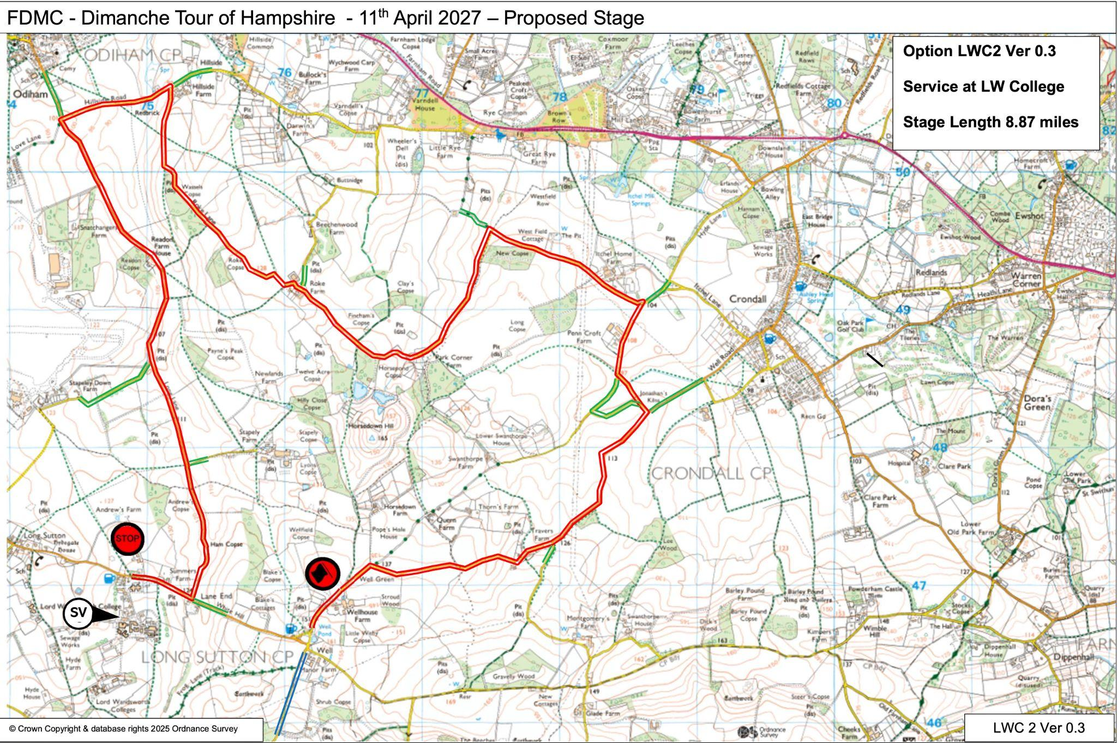

Slide 6
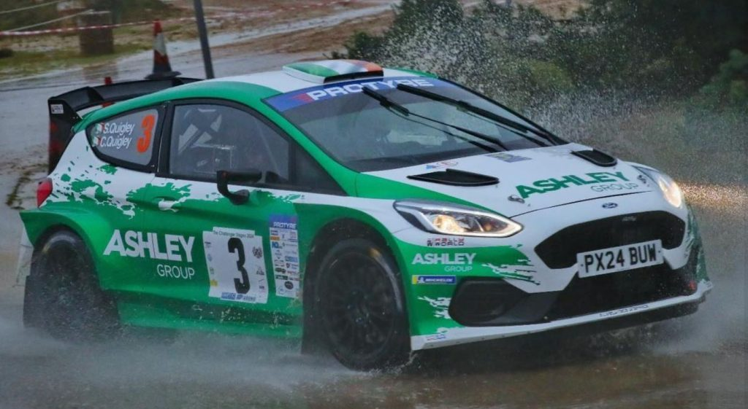
About our sponsor
Ashley Group is a main contractor providing construction, maintenance and refurbishment services throughout London and the South East. FDMC are grateful to Directors Sean & Colin Quigley, who are regular competitors.

Slide 7

Thank you!
Scan for community information
Email: dimanchetour@fdmc.org.uk

