Slide 1
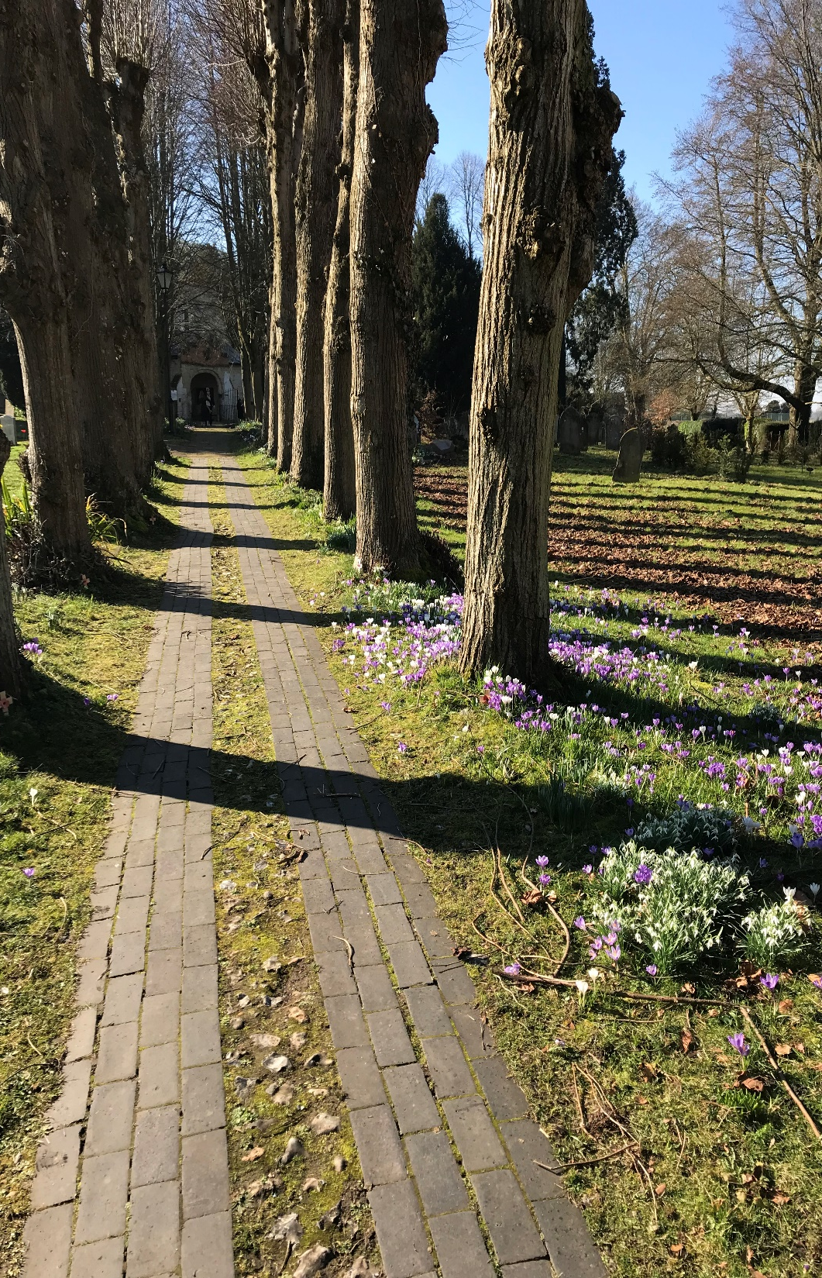
Crondall Parish Council
Additional Planning Presentation
September 2026

Slide 2
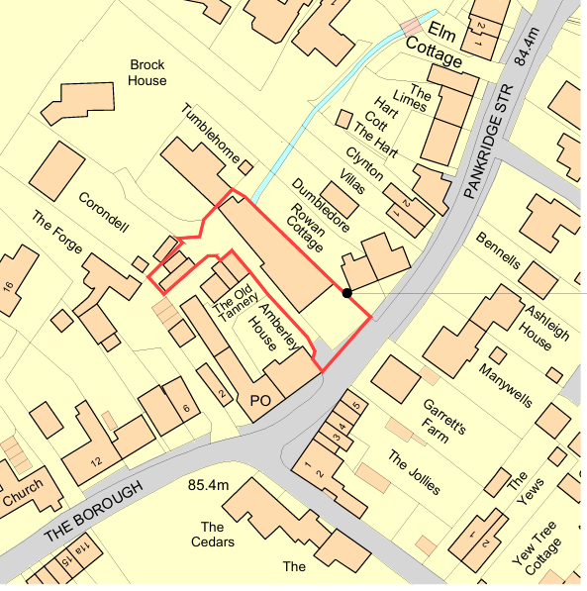
Ref: 26/01224/FUL
Property: | Phantom Motors Cars, Pankridge Street
Application Type: | Full
Description: | Demolition of car showroom and workshop and erection of two dwellings, shed and detached garage.
  Located within the Settlement
  Boundary
  Located within the Conservation Area

Slide 3
Ref: 26/01224/FUL
Demolition of existing garage and workshops
Development of 2 houses – one 4 bed with detached garage and one smaller 3 bed house
The two dwellings are of simple traditional two-storey design in locally appropriate materials, of similar scale and proportions to nearby houses in the conservation area.
Both have gardens and parking spaces
The application is accompanied by a Heritage Impact Statement which reflects its location within Crondall Conservation Area and is adjacent to several Grade II listed buildings, including Rowan Cottage and Dumbledore, Garrett's Farmhouse and Amberley House.

Slide 4
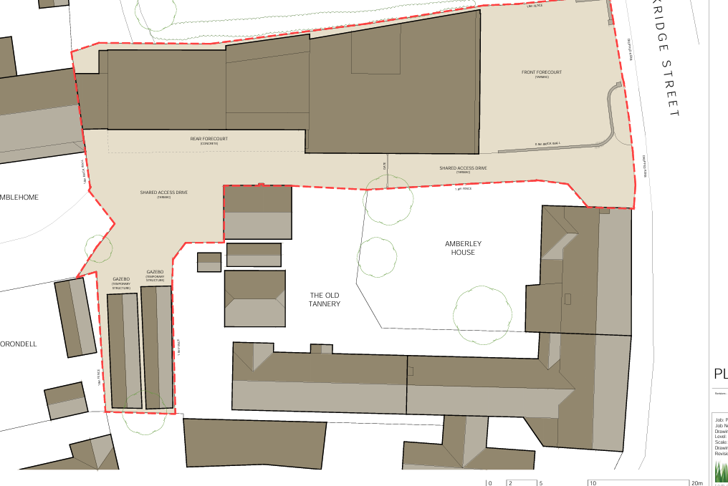
Ref: 26/01224/FUL

Slide 5
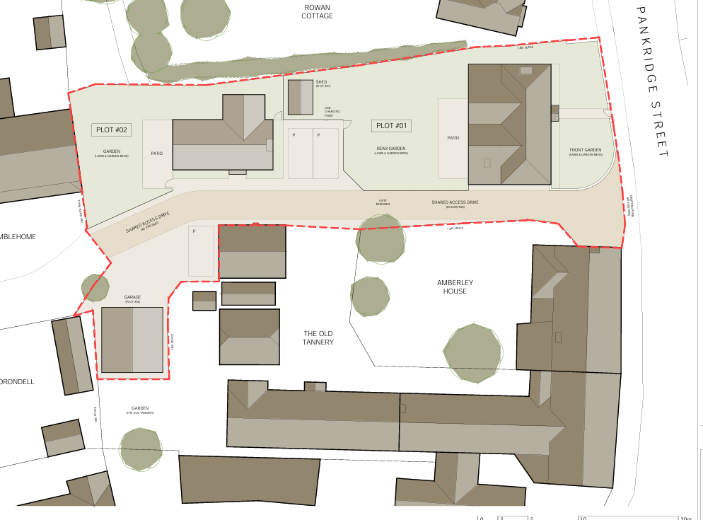
Ref: 26/01224/FUL
Layout

Slide 6
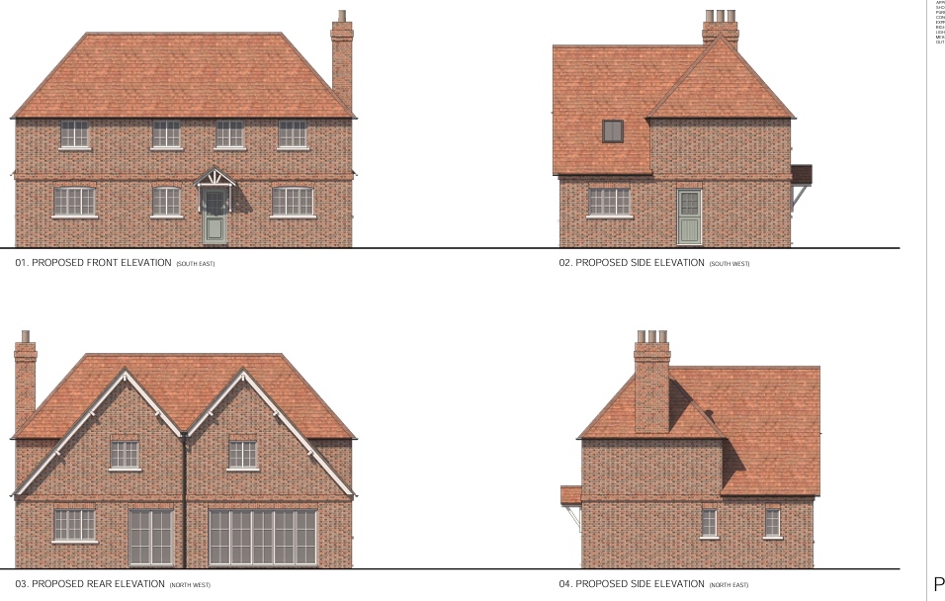
Ref: 26/01224/FUL
Plot 1

Slide 7
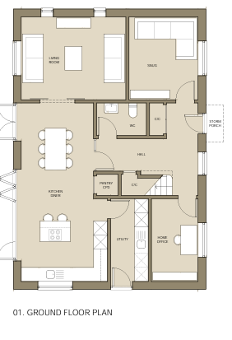
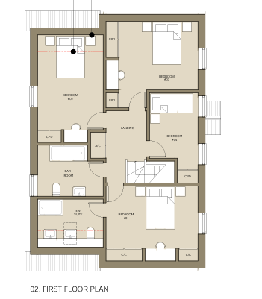
Ref: 26/01224/FUL
Plot 1

Slide 8
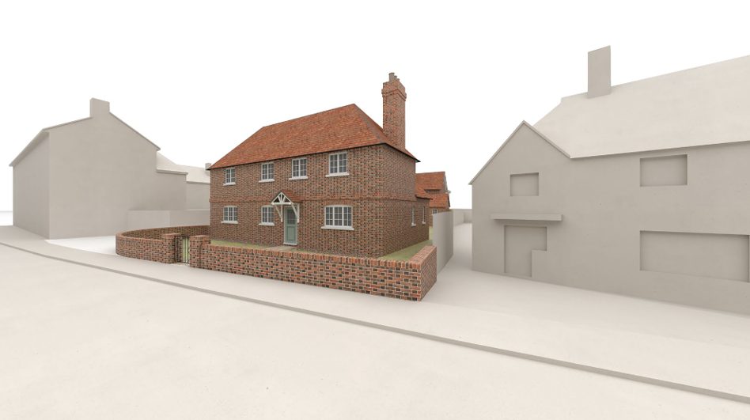
Ref: 26/01224/FUL

Slide 9
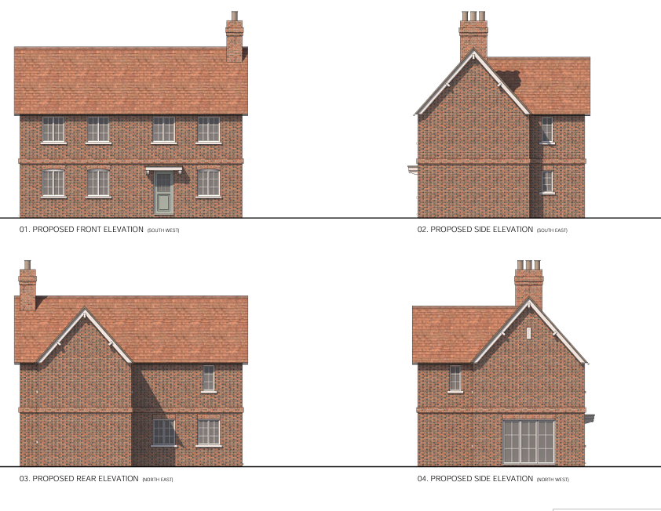
Ref: 26/01224/FUL
Plot 2

Slide 10
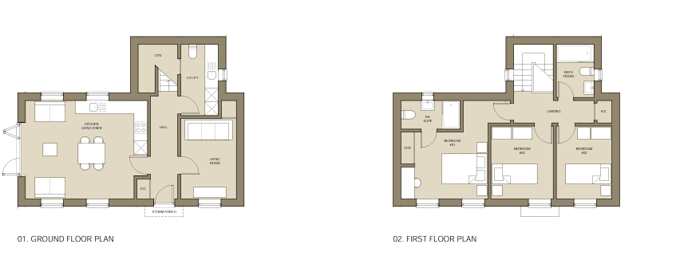
Ref: 26/01224/FUL
Plot 2

Slide 11
Ref: 26/01224/FUL
Attractive development in proportion to the site
Scheme provides two appropriately sized dwellings in the centre of the village with access to all local amenities
The two dwellings replace an unattractive 1960’s extended former petrol filing station.
The scheme will reduce traffic at what is a congested part of Pankridge Street

Slide 12
Ref: 26/01224/FUL
Recommendation: No Objection

Slide 13
Notes
All views expressed are my own. This presentation is prepared for the use of the Parish Council and is not intended for onward publication.

